Slide 1
2019-20 NFHS SOCCER Rules Power Point
Welcome to the 2019-20 Soccer Power Point Presentation.
Notes:
Welcome to the 2019-20 Soccer Power Point Presentation.

Slide 2
SOCCER RULES book CORRECTION
2019-20 NFHS
Notes:
SOCCER RULES BOOK CORRECTION

Slide 3
Rule 2-2-4 Correction
If the ball becomes deflated during play, it is declared dead where it was last played and the game is resumed by a drop ball between any number of opposing players at the spot where it was last played. If the ball becomes deflated within the goal area, then the ball is dropped between any number of opposing players subject to the provisions of Rule 9-2-2.
Notes:
RULE 2-2-4 CORRECTION
If the ball becomes deflated during play, it is declared dead where it was last played and the game is resumed by a drop ball between any number of opposing players at the spot where it was last played. If the ball becomes deflated within the goal area, then the ball is dropped between any number of opposing players subject to the provisions of Rule 9-2-2.

Slide 4
Rule 3-4-3
The clock shall be stopped when a substitute by the team in the lead is beckoned onto the field in the final five minutes of the second period, in the fourth quarter (if the game is played in quarters) and in the second period of the overtime.
Notes:
Rule 3-4-3
The clock shall be stopped when a substitute by the team in the lead is beckoned onto the field in the final five minutes of the second period only, in the fourth quarter (if the game is played in quarters) and in the second half of the overtime.

Slide 5
Rule 7-4-3
The clock shall be stopped when a substitute by the team in the lead is beckoned onto the field in the final five minutes of the second period only, the second period of overtime and the fourth period (if the state plays in quarters.)
Notes:
Rule 7-4-3
The clock shall be stopped when a substitute by the team in the lead is beckoned onto the field in the final five minutes of the second period only, the second period of overtime and the fourth period (if the state plays in quarters.)

Slide 6
SOCCER RULES CHANGES
2019-20 NFHS
Notes:
2019-20 NFHS
SOCCER RULES CHANGES

Slide 7
Rule 4-3 improperly equipped
Improperly Equipped Players (18-1-1u)
Cautions will not be issued for improperly equipped player(s).
If not immediately correctable, improperly equipped player(s) shall be instructed to leave the field of play when the ball next ceases to be in play. The player(s) may be replaced. The removed player(s), if not replaced, may re-enter at the next dead ball only after reporting to an official, who shall be satisfied the player’s equipment and uniform are in order. Play shall not be stopped for an infringement of this rule except that the referee may stop play immediately where there is a dangerous situation.
Notes:
Rule 4-3
Improperly Equipped Players (18-1-1u)
Cautions will not be issued for improperly equipped player(s).
If not immediately correctable, improperly equipped player(s) shall be instructed to leave the field of play when the ball next ceases to be in play. The player(s) may be replaced. The removed player(s), if not replaced, may re-enter at the next dead ball only after reporting to an official, who shall be satisfied the player’s equipment and uniform are in order. Play shall not be stopped for an infringement of this rule except that the referee may stop play immediately where there is a dangerous situation.
Rationale: The change corrects an injustice. For the far more serious infringement of illegal equipment, the offending team does not play shorthanded. For the less serious offense of improper equipment, they are required to play shorthanded. The change addresses this inequity.

Slide 8
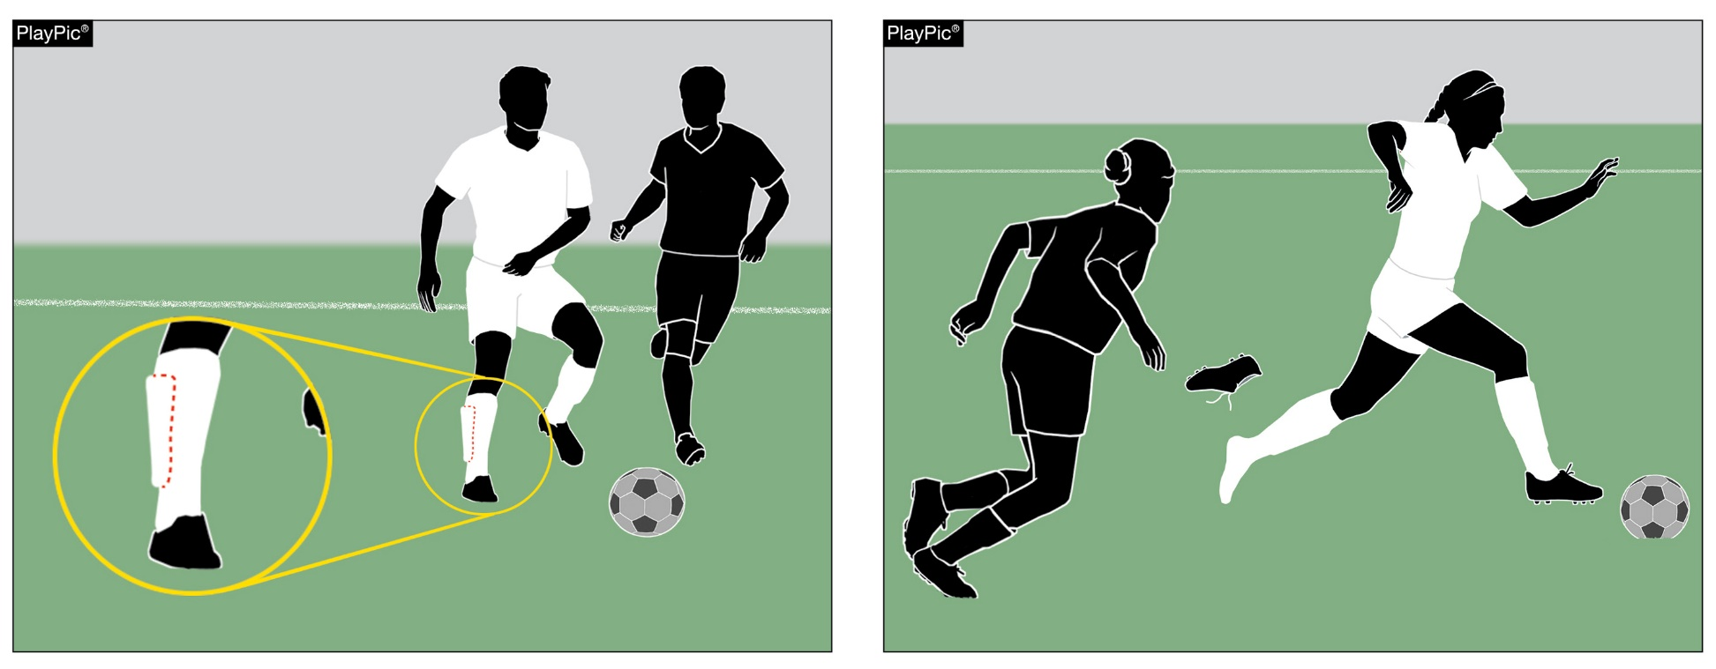
4-3 Improperly Equipped
An improperly equipped player is wearing legal equipment that is being worn incorrectly or becomes illegal during play.
Notes:
4-3 Improperly Equipped
A person wearing legal equipment that is being worn incorrectly or becomes illegal during play.

Slide 9
Rule 5-3-1d advantage signal
The officials shall:
(d) call out "play on" and, with an underswing of one or both arms, indicate a foul which was observed but shall go unpenalized because penalizing the offending team would give an advantage to the offending team. If the referee applies the advantage, which was anticipated but does not develop at that time, the referee shall penalize the original offense.
Notes:
Rule 5-3-1d
The officials shall:
(d) call out "play on" and, with an underswing of one or both arms, indicate a foul which was observed but shall go unpenalized because penalizing the offending team would give an advantage to the offending team. If the referee applies the advantage, which was anticipated but does not develop at that time, the referee shall penalize the original offense.
Rationale: This change permits the use of one arm to signal advantage.

Slide 10
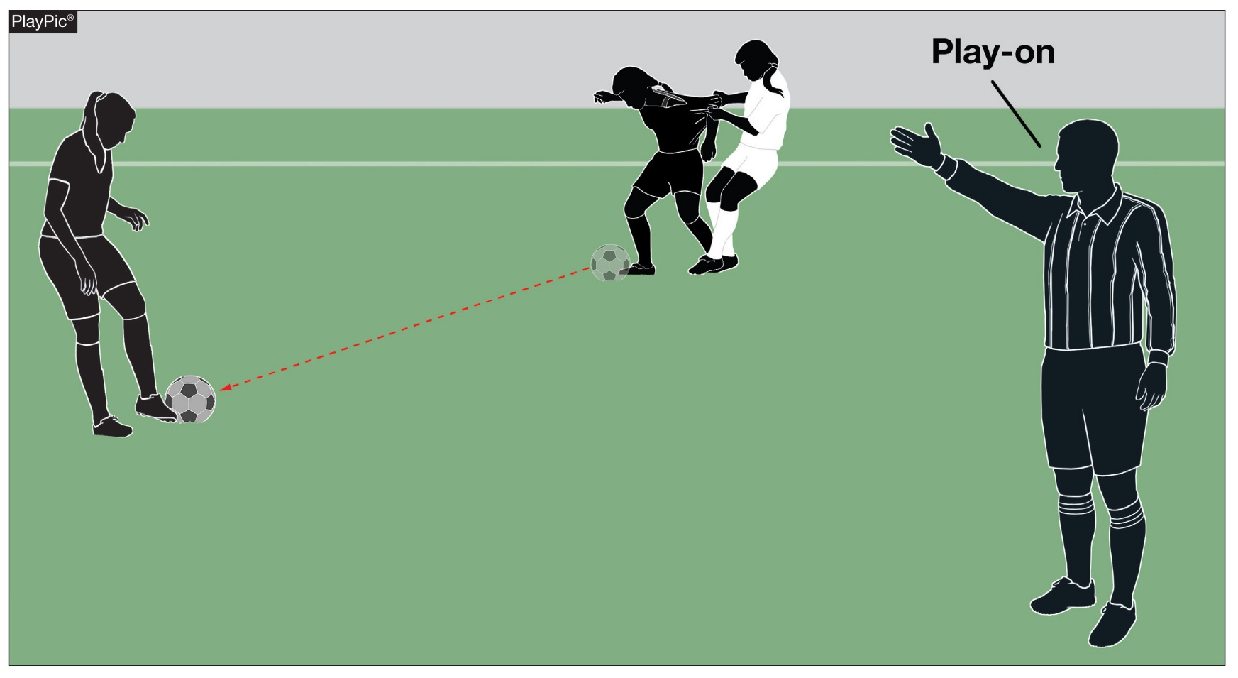
5-3-1d Advantage Signal
Use of one arm to signal advantage is permitted.
Notes:
5-3-1d Advantage Signal
Use of one arm to signal advantage is permitted.

Slide 11
Rule 7-4-3 time-out and in - NEW
The clock shall be stopped when a substitute by the team in the lead is beckoned onto the field in the final five minutes of the second period only, the second period of overtime and the fourth period (if the state plays in quarters.)
Notes:
Rule 7-4-3 NEW
The clock shall be stopped when a substitute by the team in the lead is beckoned onto the field in the final five minutes of the second period only, the second period of overtime and the fourth period (if the state plays in quarters.)
Rationale: Coaches in the lead will make multiple substitutions in the later stages of the match. The tactic is being used as a time-wasting ploy. Adding this rule will help the game to be decided by the players and not a coach who is wasting time when in the lead. These substitutes are usually players from the far side of the field that take more time off the clock. This addition would stop this practice.

Slide 12
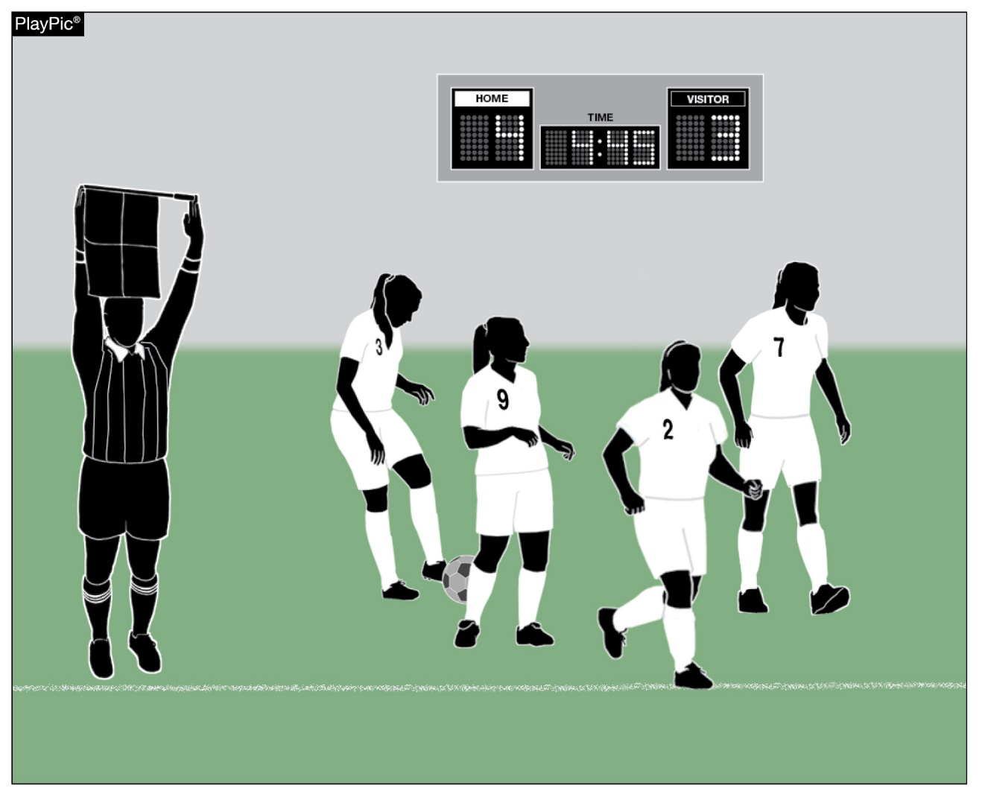
7-4-3 Time-Out and In
The clock shall be stopped when a substitute by the team in the lead is beckoned on the field in the final five minutes of the second period only during regulation time , the second period of overtime and the fourth period (if the state plays in quarters).
Notes:
7-4-3 Time-Out and In
The clock shall be stopped when a substitute by the team in the lead is beckoned on the field in the final five minutes of the second period only during regulation time , in overtime
and in the 4 period for those states that play using quarters.
The clock shall be stopped when a substitute by the team in the lead is beckoned onto the field in the final five minutes of the second period only, the second period of overtime and the fourth period (if the state plays in quarters.)

Slide 13
Rule 3-4-3 substitutions - NEW
The clock shall be stopped when a substitute by the team in the lead is beckoned on the field in the final five minutes of the second period only, in the second period of overtime or in the fourth quarter (when quarters are used.)
Notes:
Rule 3-4-3 NEW
The clock shall be stopped when a substitute by the team in the lead is beckoned on the field in the final five minutes of the second period only, in the second period overtime or in the fourth quarter (when quarters are used.)
Rationale: Rule affected by change in 7-4-3.

Slide 14
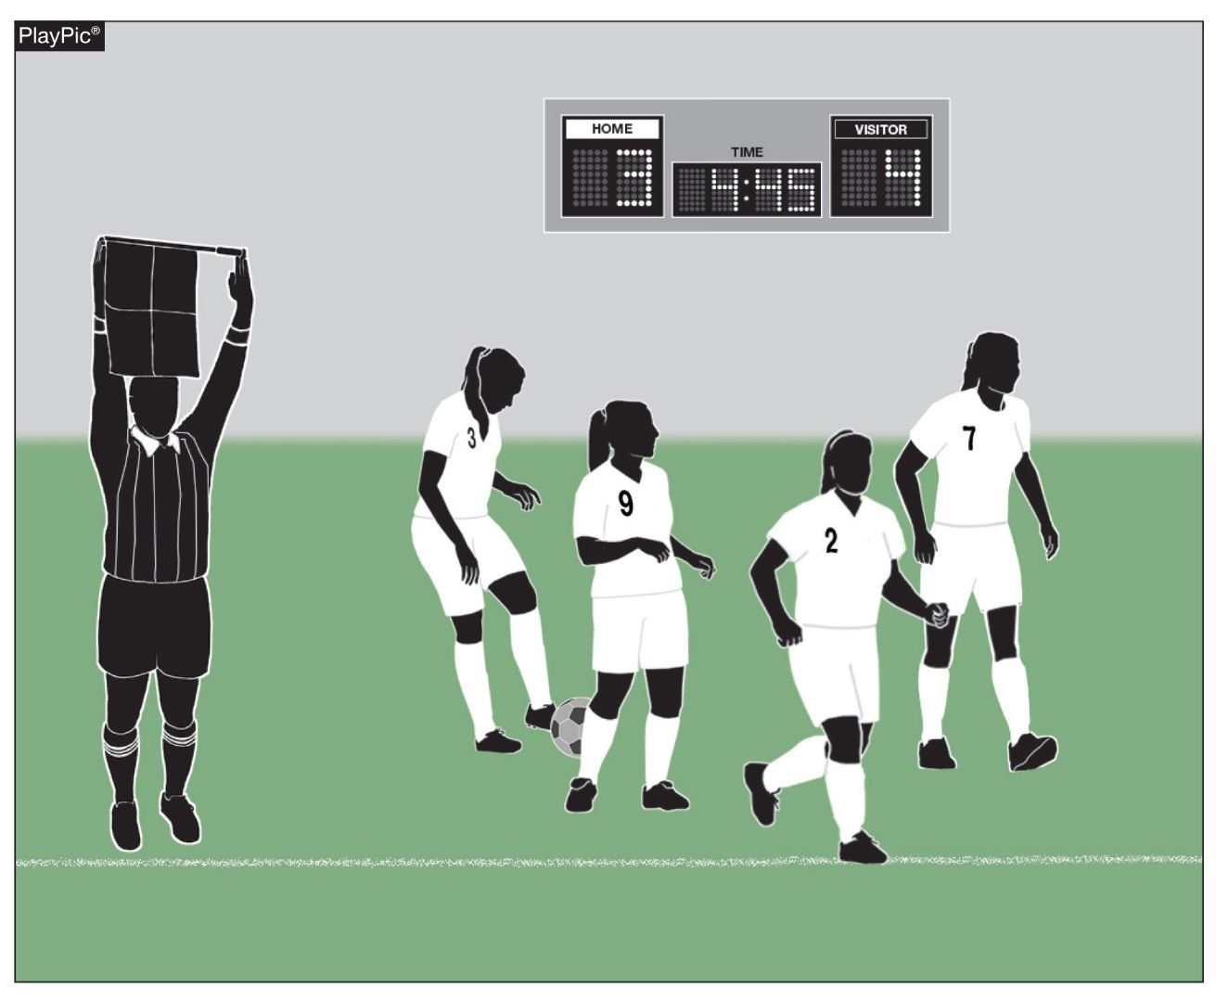
3-4-3 substitutions
The clock shall be stopped when a substitute by the team in the lead is beckoned onto the field in the final five minutes of the second period, in the fourth quarter (if the game is played in quarters) and in the second period of the overtime.
Notes:
3-4-3 Substitutions
The clock shall be stopped when a substitute by the team in the lead is beckoned onto the field in the final five minutes of the second period, in the fourth quarter (if the game is played in quarters) and in the second period of the overtime.

Slide 15
Rule 9-2-1 drop ball
The game is restarted with a drop ball:
a. when the ball is caused to go out of bounds by two opponents simultaneously;
b. when the ball becomes deflated;
c. following temporary suspension of play for an injury or unusual situation and a goalkeeper is not in possession of the ball.
d. when simultaneous fouls of the same degree occur by opponents.
Notes:
Rule 9-2-1
The game is restarted with a drop ball:
a. when the ball is caused to go out of bounds by two opponents simultaneously;
b. when the ball becomes deflated;
c. following temporary suspension of play for an injury or unusual situation and a goalkeeper is not in possession of the ball.
d. when simultaneous fouls of the same degree occur by opponents.
Rationale: This rule changes the awarding of a free kick to a drop ball thereby possibly creating a scoring opportunity for a team underseving.

Slide 16
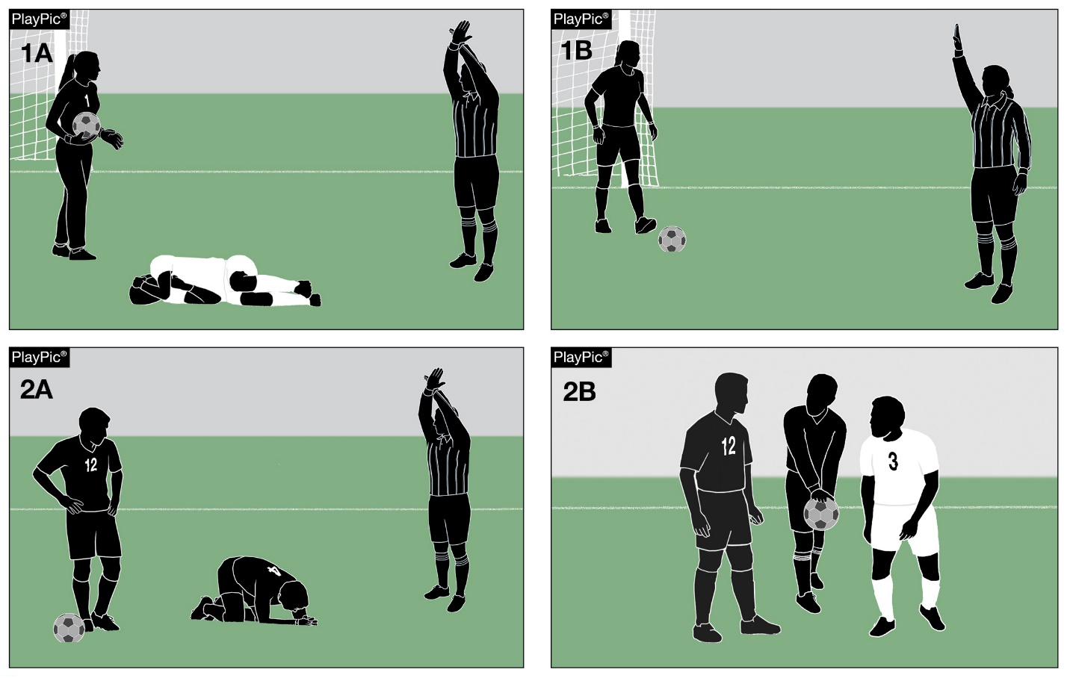
9-2-1 Drop Ball
Unless a goalkeeper is in possession of the ball, the restart following a temporary suspension of play for an injury or unusual situation is a drop ball.
Notes:
9-2-1 Drop Ball
Unless a goalkeeper is in possession of the ball, the restart following a temporary suspension of play for an injury or unusual situation is a drop ball.

Slide 17
Rule 9-2-3 drop ball
The ball is dropped by an official from waist level to the ground. Any number of players may contest a dropped ball (including the goalkeepers); a referee cannot decide who may contest a dropped ball or its outcome.
Notes:
Rule 9-2-3
The ball is dropped by an official from waist level to the ground. Any number of players may contest a dropped ball (including the goalkeepers); a referee cannot decide who may contest a dropped ball or its outcome.
Rationale: This addition helps to provide clarity in the application of this rule.

Slide 18
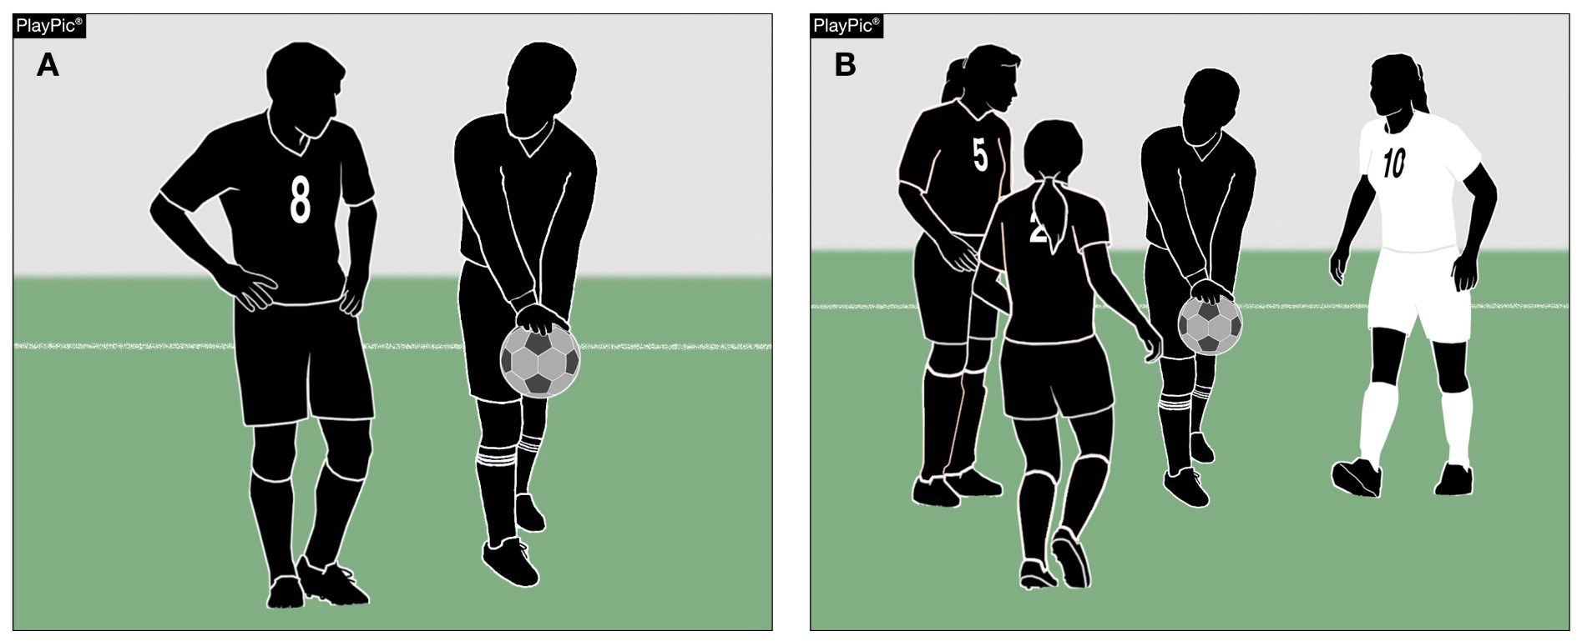
9-2-3 Drop Ball
Any number of players may contest a dropped ball, including goalkeepers.
Notes:
9-2-3 Drop Ball
Any number of players may contest a dropped ball, including goalkeepers.

Slide 19
Rule 9-2-5 drop ball NEW
The ball shall be dropped again if it touches a player before it touches the ground or leaves the field of play after it touches the ground without touching a player.
Notes:
Rule 9-2-5 NEW
ART. 5 . . . The ball shall be dropped again if it touches a player before it touches the ground or leaves the field of play after it touches the ground without touching a player.
Rationale: This addition helps to avoid confusion and allow the rule to be more equitable under the circumstances.

Slide 20
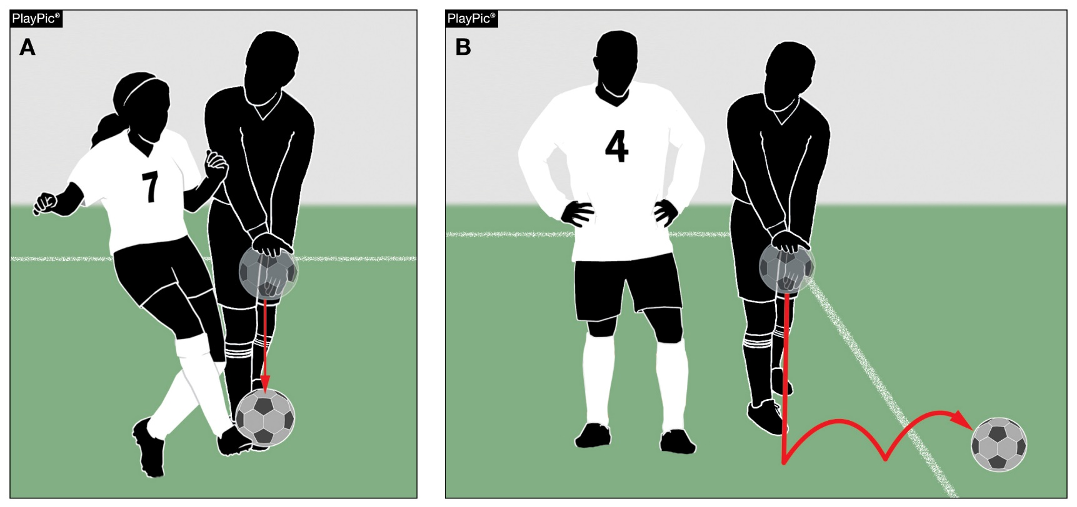
9-2-5 Drop Ball
The dropped ball is repeated if it touches a player before it touches the ground or it leaves the field of play before it is touched.
Notes:
9-2-5 Drop Ball
The dropped ball is repeated if it touches a player before it touches the ground or it leaves the field of play before it is touched.

Slide 21
Rule 9-2-6 drop ball NEW
If a dropped ball enters the goal without touching at least two players, play is restarted with a goal kick if it enters the opponent’s goal or a corner kick if it enters the team's own goal, depending on which player touched the ball last.
Notes:
Rule 9-2-6 NEW
ART. 6 . . . If a dropped ball enters the goal without touching at least two players, play is restarted with a goal kick if it enters the opponent’s goal or a corner kick if it enters the team's own goal, depending on which player touched the ball last.
Rationale: This addition helps to avoid confusion and allow the rule to be more equitable under the circumstances.

Slide 22
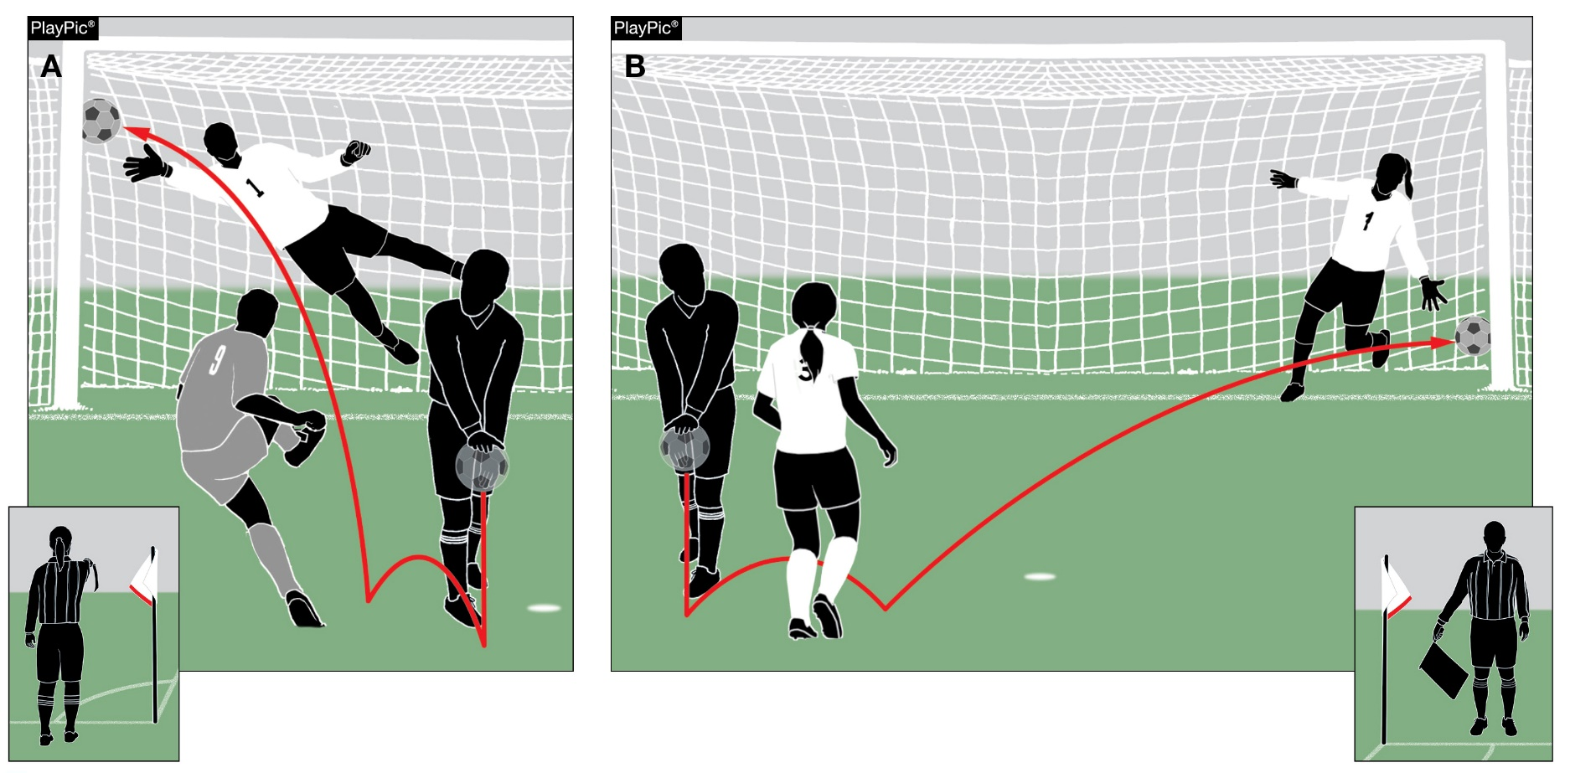
9-2-6 Drop Ball
A goal cannot be scored directly from a drop ball; the ball must touch at least two players before entering the goal.
Notes:
9-2-6 Drop Ball
A goal cannot be scored directly from a drop ball; the ball must touch at least two players before entering the goal.

Slide 23
Rule 9-3 drop ball
In case of a temporary suspension due to injury or any unusual situation the game shall be started by a drop ball at the point where the ball was when the play was suspended (except as noted in 14-1-7), provided the ball was not in the goal area and not in the possession of the goalkeeper. 12-8-2
Notes:
Rule 9-3
In case of a temporary suspension due to injury or any unusual situation the game shall be started by a drop ball at the point where the ball was when the play was suspended (except as noted in 14-1-7), provided the ball was not in the goal area and not in the possession of the goalkeeper. 12-8-2
Rationale: This change will eliminate free kick opportunities that often create scoring opportunities that are not deserved.

Slide 24
SOCCER Major editorial change
2019-20 NFHS
Notes:
2019-20 NFHS
SOCCER MAJOR EDITORIAL CHANGE

Slide 25
Rule 4-2-6 other equipment
Hearing aids worn in or behind the ears, including cochlear implants, are legal provided that the device does not create the threat of injury.
Notes:
Rule 4-2-6
Hearing aids worn in or behind the ears, including cochlear implants, are legal provided that the device does not create the threat of injury.

Slide 26
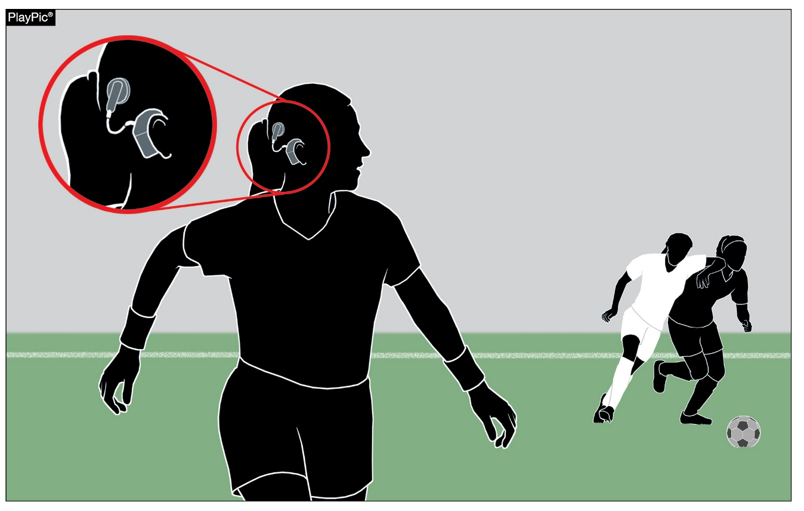
4-2-4 Equipment
Cochlear implants can be worn if they do not provide a threat of injury to players.
Notes:
4-2-4 Equipment
Cochlear implants can be worn if they do not provide a threat of injury to players.

Slide 27
SOCCER points of emphasis
2019-20 NFHS
Notes:
2019-20 NFHS
SOCCER POINTS OF EMPHASIS

Slide 28
Pre-game communication between the school administration and game officials
An authorized representative of the host school shall greet the officials upon their arrival. The host school principal, principal’s designee or game administrator must indicate to the head official or center referee his/her location should a situation develop where his/her assistance is needed during a contest. The contest coaches should not serve as the principal’s designee or game administrator. The expectation is that the principal’s designee or game administrator will take positive action to maintain an atmosphere of good sportsmanship within the spectator seating area.
Notes:
Pre-game communication between the school administration and game officials
An authorized representative of the host school shall greet the officials upon their arrival. The host school principal, principal’s designee or game administrator must indicate to the head official or center referee his/her location should a situation develop where his/her assistance is needed during a contest. The contest coaches should not serve as the principal’s designee or game administrator. The expectation is that the principal’s designee or game administrator will take positive action to maintain an atmosphere of good sportsmanship within the spectator seating area.

Slide 29
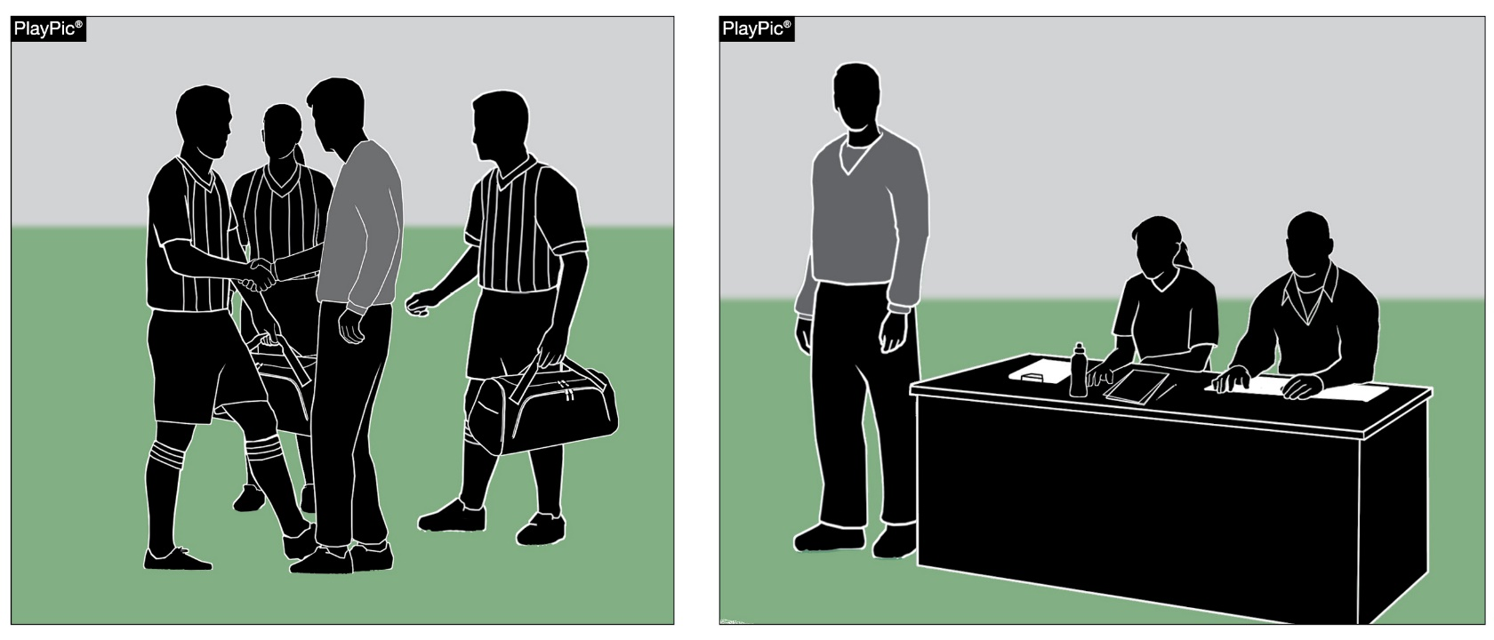
Pre-game Communication Between the School Administration and Game Officials
The site administrator should indicate his/her general location for the contest so that the referees know where to look if there is a need.
Notes:
Pre-game Communication Between the School Administration and Game Officials
The site administrator should indicate his/her general location for the contest so that the referees know where to look if there is a need.

Slide 30
Officials communicating misconduct to coaches
NFHS Rule 5-3 states that game officials shall communicate the nature of misconduct to coaches, the scorer and other officials when a yellow/red card has been issued. This communication is a notification and not an explanation. It is not intended to be an opportunity for the coach to discuss or dissent the call. It is, however, an educational opportunity for the coach to address and/or correct the behavior of the carded individual.
Notes:
Officials communicating misconduct with coaches
NFHS Rule 5-3 states that game officials shall communicate the nature of misconduct to coaches, the scorer and other officials when a yellow/red card has been issued. This communication is a notification and not an explanation. It is not intended to be an opportunity for the coach to discuss or dissent the call. It is, however, an educational opportunity for the coach to address and/or correct the behavior of the carded individual.

Slide 31
Officials communicating misconduct to coaches (con’t.)
It is important to note that interscholastic athletics are an extension of the classroom and the behavior of all involved should reflect as such. Coaches and officials are expected to model good sportsmanship and to uphold the honor and dignity of their profession. This includes all interactions with student-athletes, other coaches and officials, school administration and spectators.
Notes:
Officials communicating misconduct with coaches (con’t.)
It is important to note that interscholastic athletics are an extension of the classroom and the behavior of all involved should reflect as such. Coaches and officials are expected to model good sportsmanship and to uphold the honor and dignity of their profession. This includes all interactions with student-athletes, other coaches and officials, school administration and spectators.

Slide 32
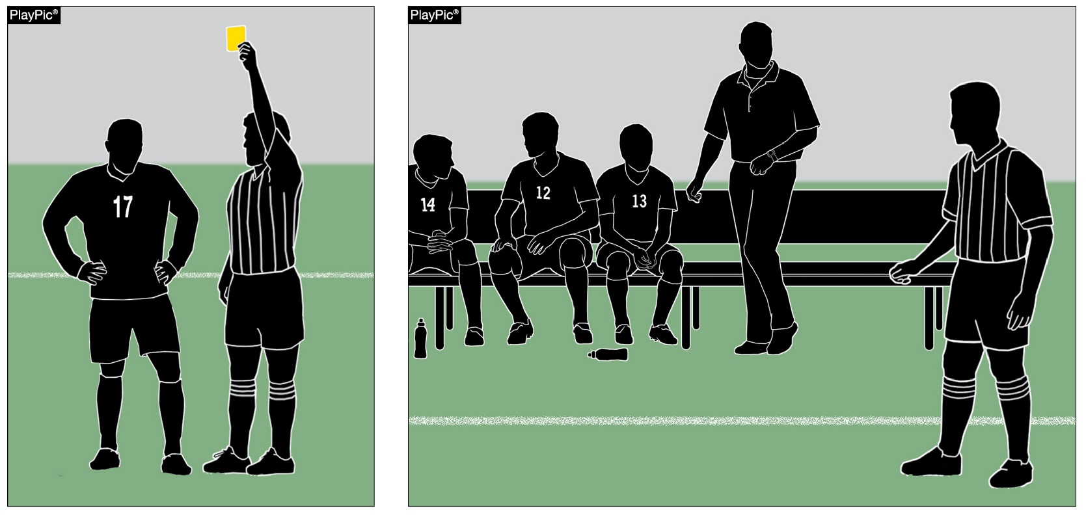
Officials Communicating Misconduct to Coaches
The referee shall communicate the nature of the misconduct to coaches, the scorer and other officials when a yellow/red card is issued.
Notes:
Officials Communicating Misconduct to Coaches
The referee shall communicate the nature of the misconduct to coaches, the scorer and other officials when a yellow/red card is issued.

Slide 33
SOCCER UNIFORMS
2019-20 NFHS
Notes:
2019-20 NFHS
SOCCER UNIFORMS

Slide 34
NFHS SOCCER UNIFORM
Game Jersey
Home Team
Dark color contrasting white
If gray is used, the shading of the gray color should be 70% dark or darker for it to clearly contrast with white (Gray Color Spectrum Chart)
Visiting Team
All-white
No color trim
Only names and patches, emblems, logos or insignias referencing the school are allowed
2 ¼ inch square manufacturer’s logo allowed
Team members wear the same color and style uniform
Goalkeeper’s jersey must distinctively different in color from that of team members and opposing team
Notes:
NFHS SOCCER UNIFORM
Game Jersey
Home Team
- Dark color contrasting white
- If gray is used, the shading of the gray color should be 70% dark or darker for it to clearly contrast with white (Gray Color Spectrum Chart)
Visiting Team
- All-white
- No color trim
Only names and patches, emblems. Logos or insignias referencing the school are allowed
2 ¼ inch square manufacturer’s logo allowed
Team members wear the same color and style uniform
Goalkeeper’s jersey must distinctively different in color from that of team members and opposing team

Slide 35
Nfhs soccer jersey
Front of Jersey
All jerseys, including the goalkeeper, must be numbered on the front
Numbers must not be duplicated
There must be a 4-inch number on the front (jersey or shorts)
The color of the number must contrast with the color of the jersey or pants, be clearly visible and match the color of the number on the back of the jersey
Back of Jersey
All jerseys, including the goalkeeper, must be numbered on the back
Numbers must not be duplicated
There must be a 6-inch number on the back
The color of the number must contrast with the color of the jersey, be clearly visible and match the color of the number on the front of the jersey
Notes:
NFHS Soccer Jersey
Front of Jersey
All jerseys, including the goalkeeper, must be numbered on the front
Numbers must not be duplicated
There must be a 4-inch number on the front (jersey or shorts)
The color of the number must contrast with the color of the jersey or pants, clearly visible and match the color of the number on the back of the jersey
Back of Jersey
All jerseys, including the goalkeeper, must be numbered on the back
Numbers must not be duplicated
There must be a 6-inch number on the back
The color of the number must contrast with the color of the jersey, be clearly visible and match the color of the number on the front of the jersey

Slide 36
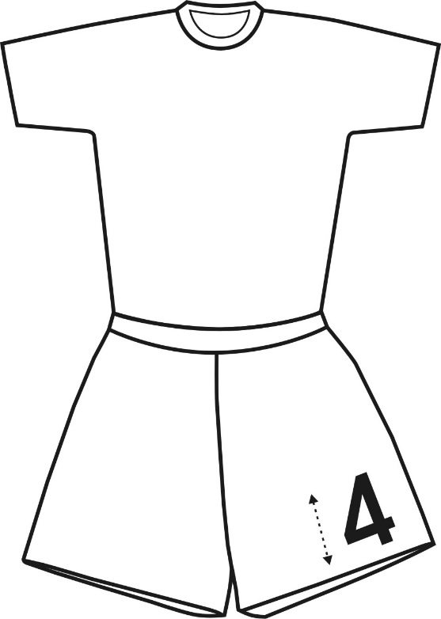
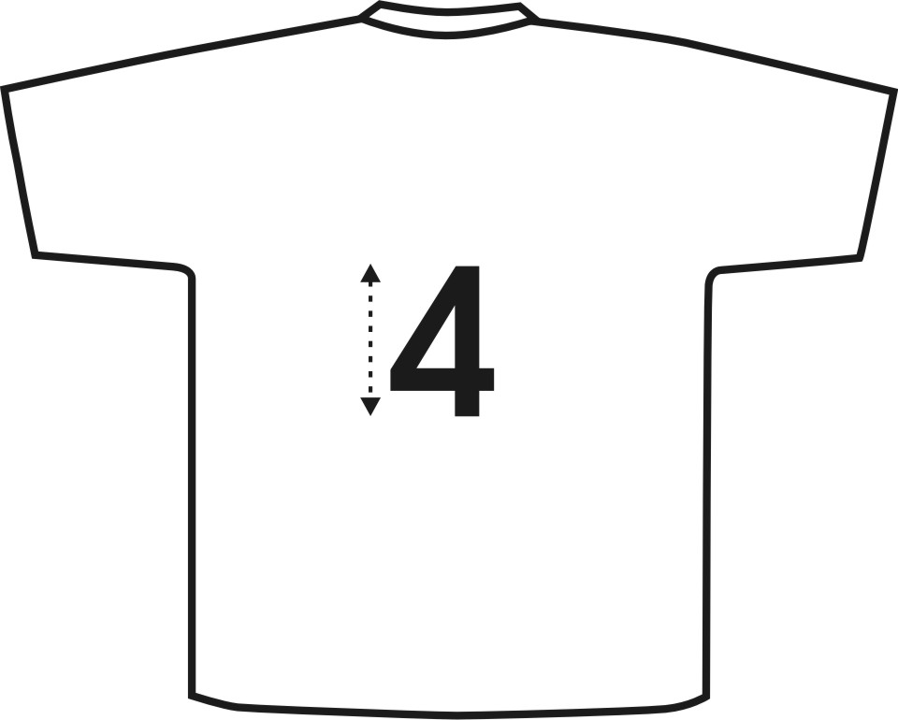
Number placement
Notes:
Number placement
There must be a 4-inch number on the front (jersey or shorts)
There must be a 6-inch number on the back

Slide 37
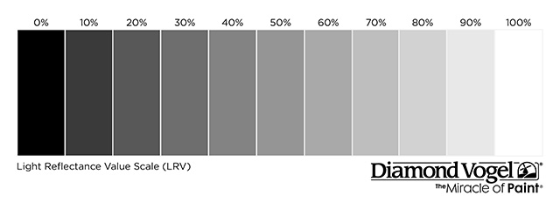
HOME Team Jerseys Gray Color Spectrum chart
100% 90% 80% 70% 60% 50% 40% 30% 20% 10% 0%
Notes:
Comment on Slide:
The NFHS has decided that beginning in 2021 in Soccer, for the color gray and/or any other light colors being used for a home jersey, it cannot go below 70% shading of the main color being used in order for it to clearly contrast with white.

Slide 38
Other items worn
Socks
Home Team
Dark color contrasting white
Does not need to match the jersey color
Both socks must be the same color
Visiting Team
All white
If tape or stays are used, they must the same color as the socks
Manufacturer’s logo on both sides of the socks is legal
Shorts
May be of a color unlike that of the jersey
May have an appropriately size manufacturer’s logo
Notes:
Other Items Worn:
Socks
Home Team
Dark color contrasting white
Does not need to match the jersey color
Both socks must be the same color
Visiting Team
All white
If tape or stays are used, they must the same color as the socks
Manufacturer’s logo on both sides of the socks is legal
Shorts
May be of a color unlike that of the jersey
May have an appropriately size manufacturer’s logo

Slide 39
Other items
Shinguards
Must meet the NOCSAE standards at time of manufacture
NOCSAE seal and height range permanently mark on front of shinguard
Worn with bottom edge no higher than 2 inches above the ankle
Age- and size-appropriate
Worn under socks
Must not be altered
Undergarments
If worn, must be of a similar length for an individual
Solid color, all alike for the team, if worn
Notes:
Other Items:
Shinguards
Must meet the NOCSAE standards at time of manufacture
NOCSAE seal and height range permanently mark on front of shinguard
Worn with bottom edge no higher than 2 inches above the ankle
Age- and size-appropriate
Worn under socks
Must not be altered
Undergarments
If worn, must be of a similar length for an individual
Solid color, all alike for the team, if worn

Slide 40
Other items
Head coverings
Goalkeeper may wear a soft-billed baseball-type hat or soft-billed visor
Soft-padded headgear is permitted
Medical or cosmetic required head coverings must be approved by the State Association
Religious required head coverings must be approved by the State Association
Notes:
Other Items:
Head coverings
Goalkeeper may wear a soft-billed baseball-type hat or soft-billed visor
Soft-padded headgear is permitted
Medical or cosmetic required head coverings must be approved by the State Association
Religious required head coverings must be approved by the State Association

Slide 41
NFHS OFFICIALS Education
2019-20 NFHS
Notes:
2019-20 NFHS
NFHS OFFICIALS EDUCATION

Slide 42
Thank You AND HAVE A GREAT SEASON
National Federation of State High School Associations PO Box 690 | Indianapolis, IN 46206 Phone: 317-972-6900 | Fax: 317.822.5700 www.nfhs.org | www.nfhslearn.com
Notes:
THANK YOU AND HAVE A GREAT SEASON!

